Slide 1
Advanced graphics-Haptic controller
Ritabrata Podder - 2019900031
Bitla Bhanu Teja - 2022701011
Lakshmi Srikanth Nallamothu - 2021900008
Yellapragada Sri Krishna Sarat Chandra - 2021122002

Slide 2
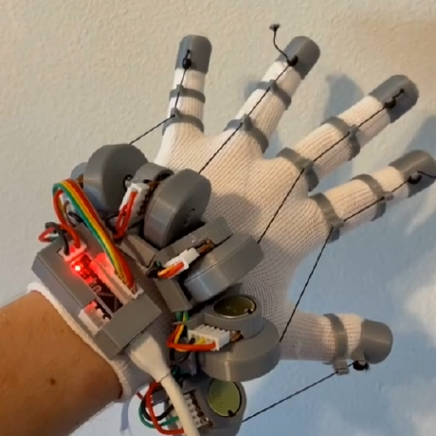
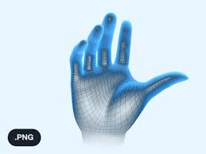
To Design a finger tracking glove that allows you to use your hands in VR.
Applications
Improves immersion
Helps to grab objects
Source: Lucid VR

Slide 3
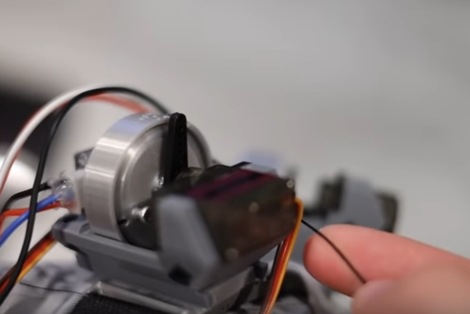
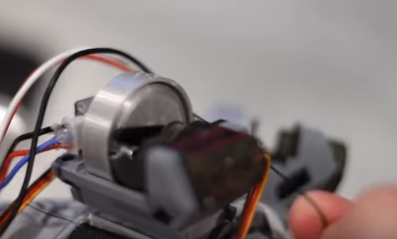
Mechanism
Uses a servo motor to restrict a string connected along the fingers from a modified Retractable Badge Reel to create a sensation of touch.
Design is bulky needs improvement
Servo state enabling free range of motion
Servo state restricting free range of motion

Slide 4
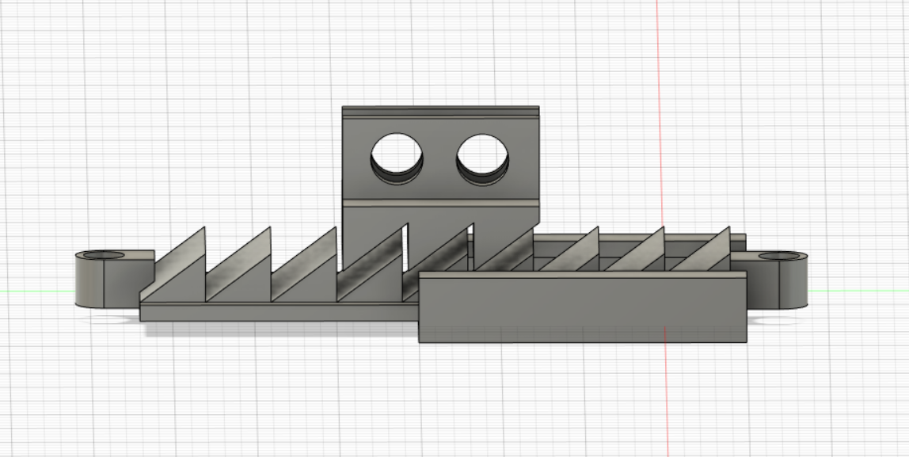
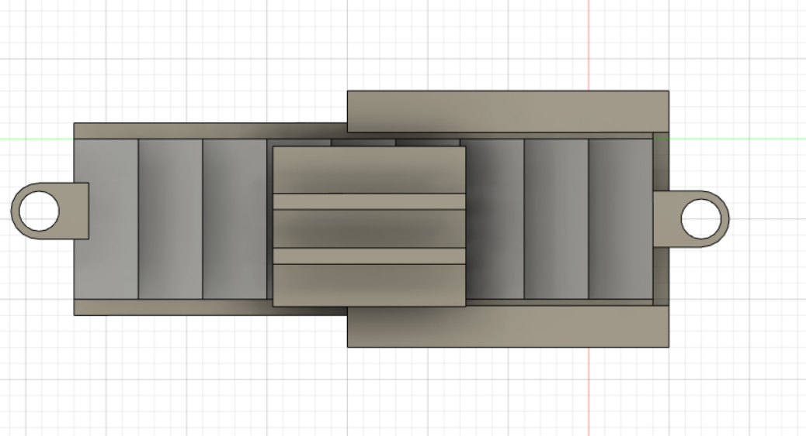
Another Approach

Slide 5
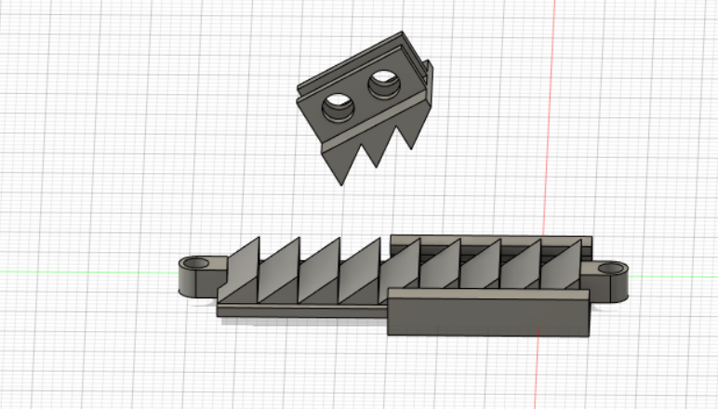
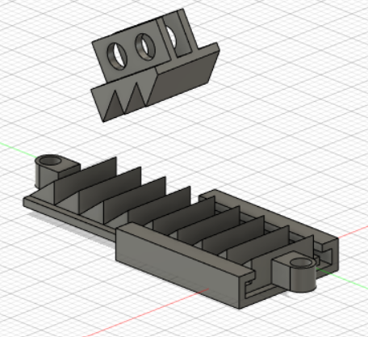

Slide 6
In the model we have proposed, the strength of motor doesn’t matter.
The maximum force of opposition is only dependant on the mechanical strength of the setup.
In the other, it is dependant on the strength of the motor.

Slide 7
Hardware Required
ESP32 Dev Board or Arduino
Some 3D printing
Glove material
Velcro strap for the rigid mount
9g servo motors for haptics(5x)
Wiring/Connectors/Breadboards as needed.
A source of power for the servos( lipo battery or power bank)
10k ohm Potentiometer or Flex Sensors(5x)
Retractable badge reels (for the rotary springs, 5x)

Slide 8
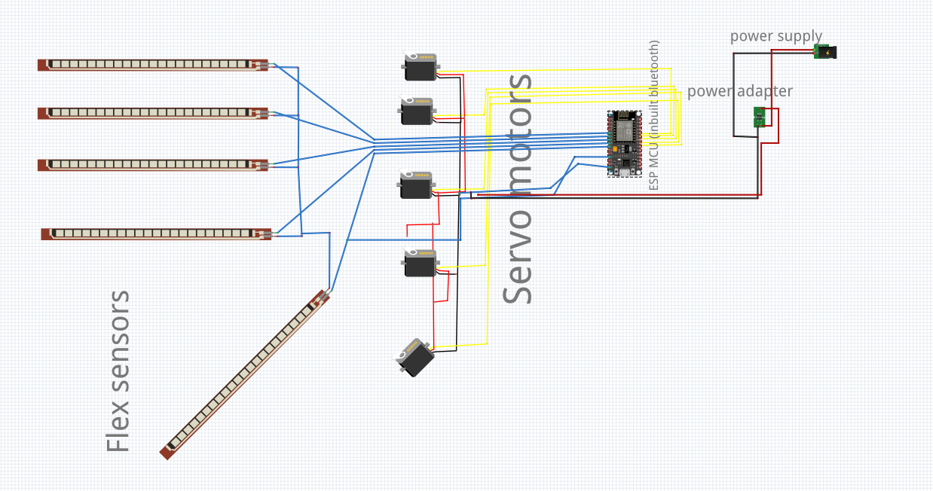

Slide 9
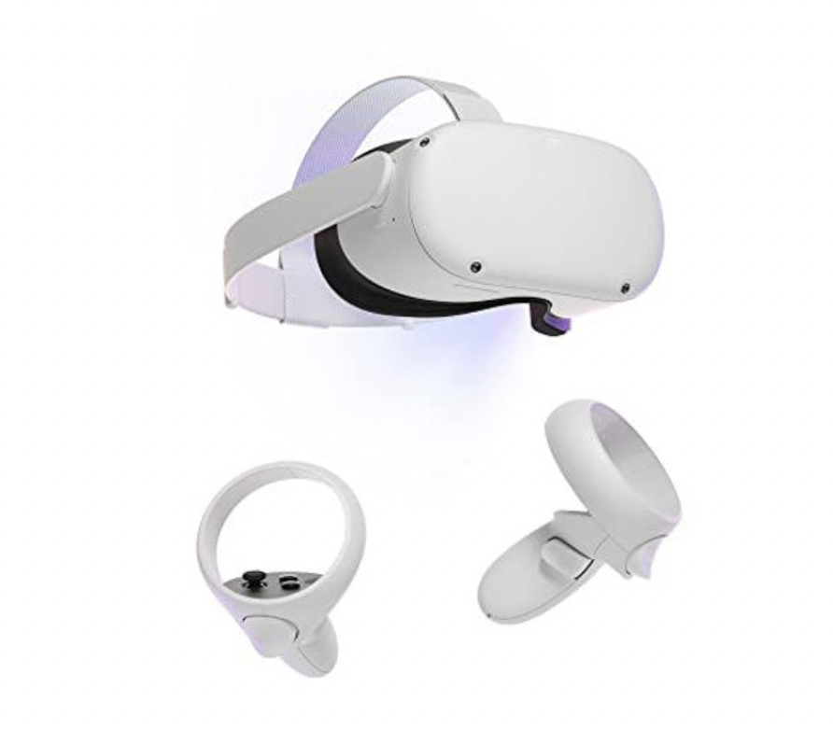
Integration of Glove to Steam VR
Oculus quest 2 HMD is used
Oculus’s controller will be used to hands in steam VR game
OpenGloves software is used to integrate glove to SteamVR game
OpenGloves is an open source OpenVR Driver that allows for use of Virtual Reality Hardware in SteamVR games.

Slide 10
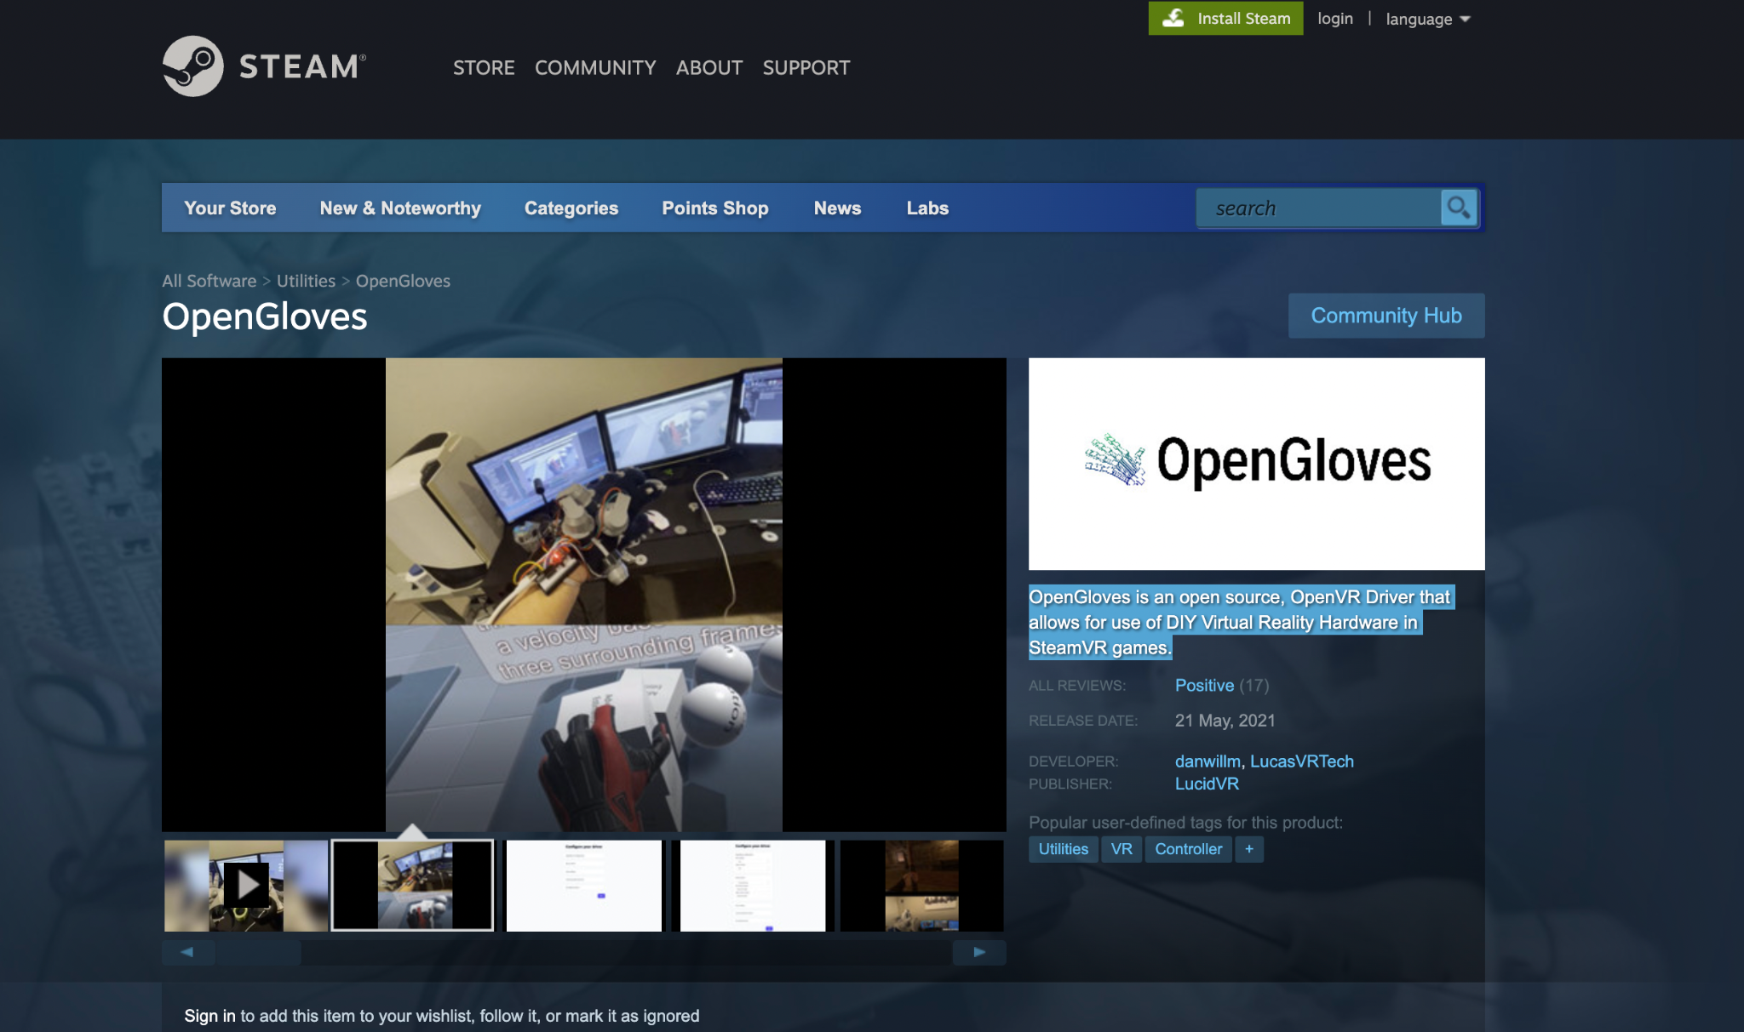
Opengloves

Slide 11
Opengloves
Features
Full Finger Tracking (Splay, Individual Joints)
Force Feedback Haptics
Positioning from Controllers/Trackers
Automatic calibration for positioning the glove relative to the controller
Button and Joystick Inputs (Joystick X,Y,Click, A Button, B Button)
Multiple communication protocols (USB, Bluetooth, Named Pipes)

Slide 12
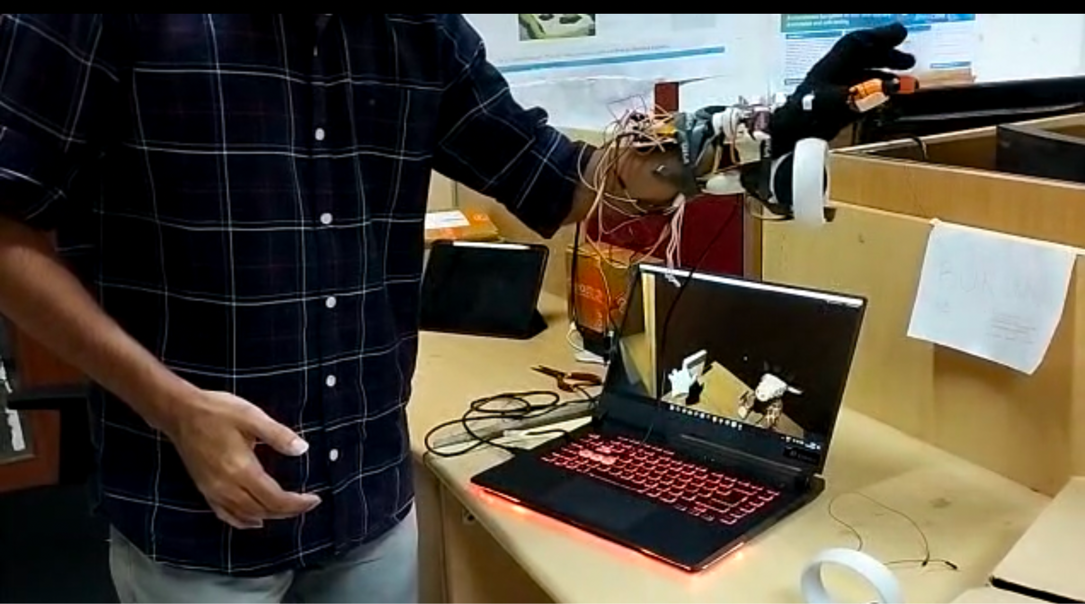
FINAL DESIGN

Slide 13


